Slide 1
Unit 2

Slide 2
Midpoint ellipse drawing algorithm
Mid-point Ellipse algorithm is used to draw an ellipse in computer graphics.

Slide 3
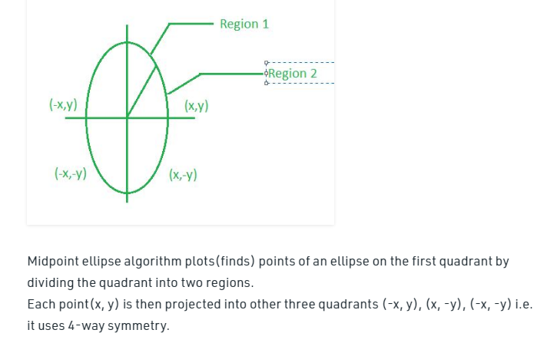

Slide 4
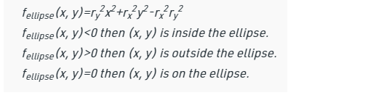
Function of ellipse

Slide 5
Algorithm

Slide 6
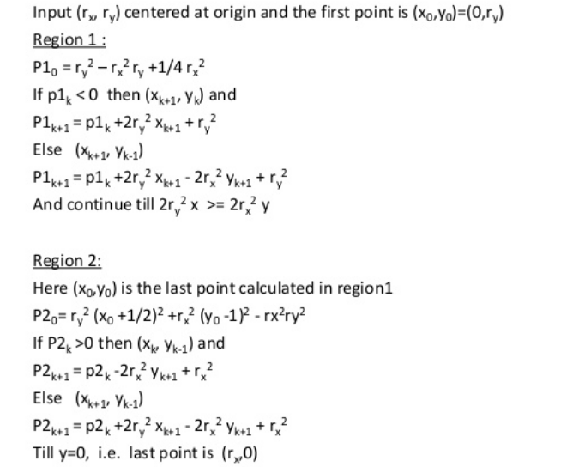

Slide 7
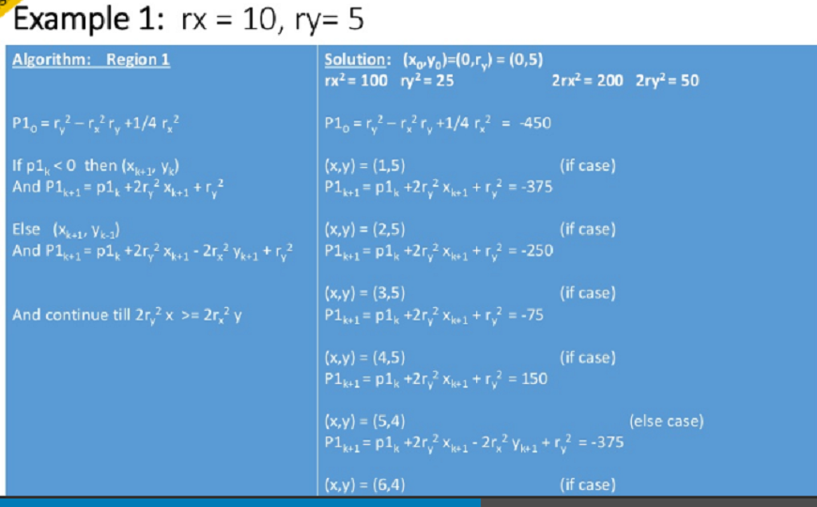

Slide 8
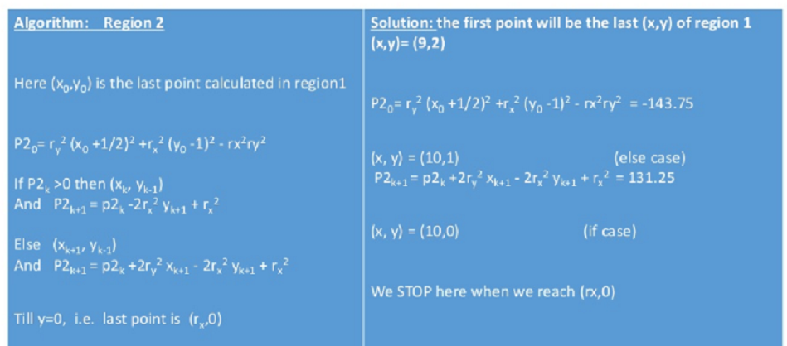

Slide 9
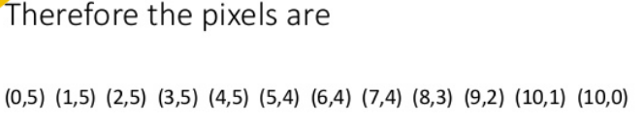

Slide 10
Video ref links
https://youtu.be/iki0JIGhMD8
https://youtu.be/a6XFLAxqqQI
Example Explanation
https://youtu.be/KbDN4WOZ3f8

